Slide 1
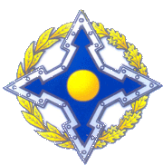
COLLECTIVE SECURITY TREATY ORGANIZATION (CSTO) INTERNATIONAL COUNTER-DRUGS OPERATIONS «CHANNEL»

Slide 2
COLLECTIVE SECURITY TREATY ORGANIZATION
MEMBERS-STATES OF COLLECTIVE SECURITY TREATY ORGANIZATION
 | Republic of Armenia Republic of Belarus Republic of Kazakhstan |  | Kyrgyz Republic Russian Federation Republic of Tajikistan

Slide 3
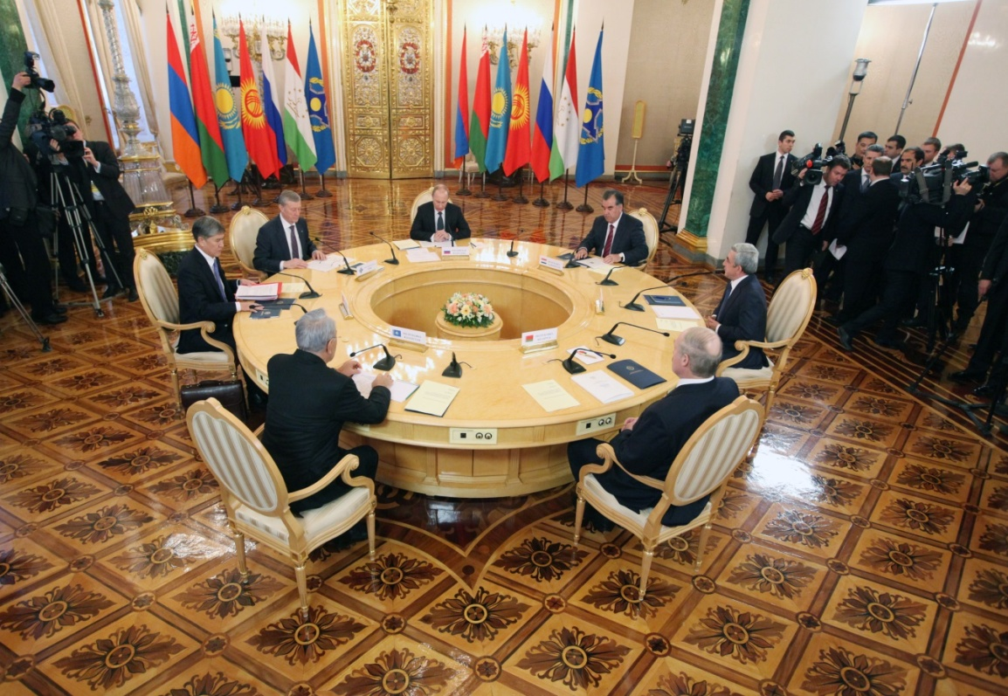
Collective Security Treaty Organization
In April 2003, at the Dushanbe summit, along with the package of decisions concerning the creation of the Collective Security Treaty Organization, the heads of the states took the decision to coordinate the activities of the CSTO member states in combating the drug threat.

Slide 4
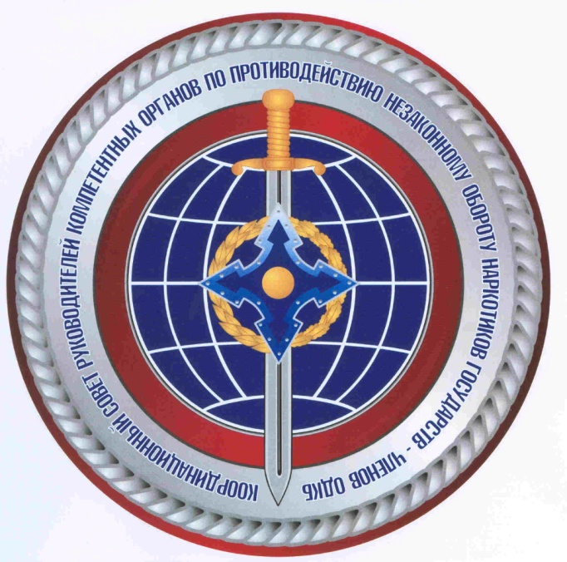
Collective Security Treaty Organization
According to the CSTO Collective Security Council resolution, in 2005 the CSTO Coordinating Council of Heads of Competent Bodies for Fighting against Illegal Drugs Trafficking was formed.

Slide 5
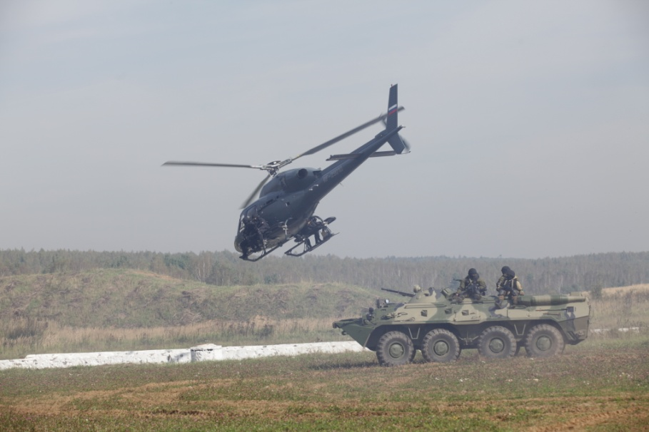
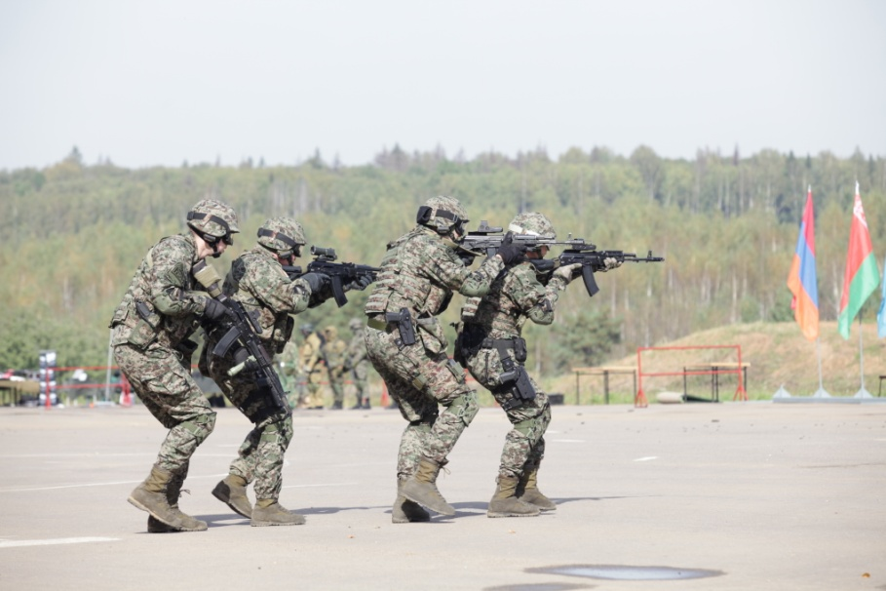
Collective Security Treaty Organization
Since 2010, the units of Special Forces of the CSTO Collective Rapid Reaction Forces (CRRF) have been reinforced with special units of the CSTO member states anti-drug agencies.

Slide 6
Collective Security Treaty Organization
The Collective security council (the CSC)
Special tactical military exercise «Thunder»
CFDT
(Coordinating Council of Heads of Competent Bodies for Fighting Illegal Drugs Trafficking)
of the CSTO Member States
SCSC of the CSTO
Coordination meeting of the CSTO member states Chief narcologists
Anti - drug units of the FDCS, CRRF of the CSTO
CFDT’s Executive Bureau of the CSTO Member States
Operation «Channel» International Coordination Headquarters
CSTO Secretariat
Working group at the CFDT
Representatives of law enforcement authorities of observer states, not members of the CSTO and other international organizations
Operation «Channel»
National
Interdepartmental Headquarters
Joint database of the CFDT
Federal Financial Monitoring Service
Basic institutions of law enforcement and intelligence agencies of the CSTO Member States:
Siberian Law Institute of the MIA of Russia
IAP of the MIA of Russia (Domodedovo)
Operation «Channel» regional interdepartmental headquarters
EAG
FIU of the CSTO Member States

Slide 7
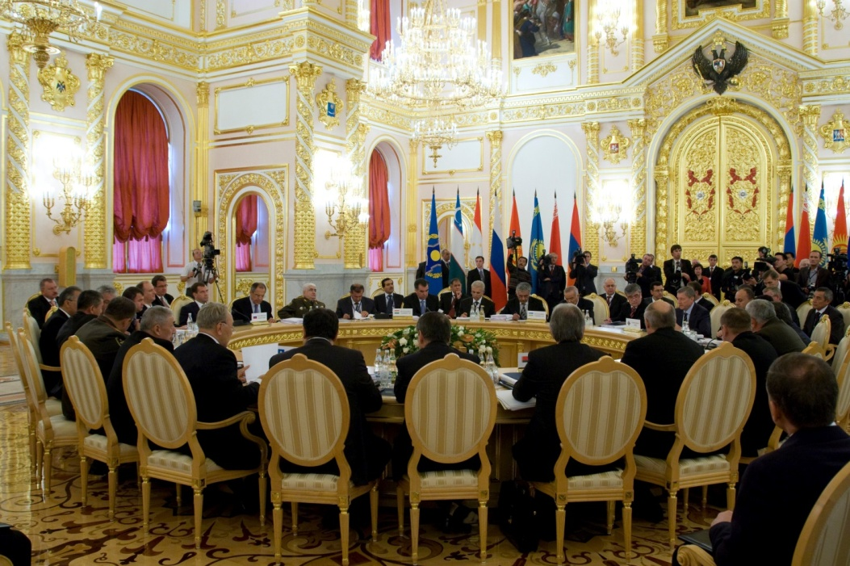
Collective Security Treaty Organization
According to the Collective Security Council Moscow session resolution
(which was held in October 2008), the operation "Channel" was transferred into the category of permanent events.
Since 2009, the active phases of the operation have been carried out in the form of special and local steps with the placement of its headquarters in the regions.

Slide 8
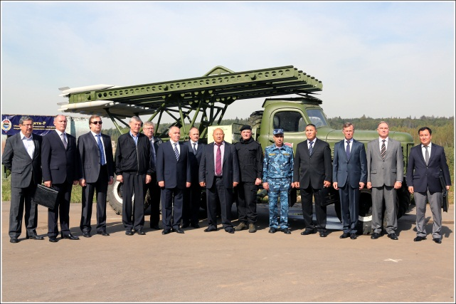
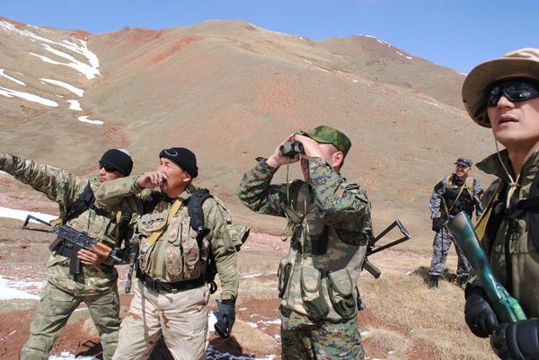
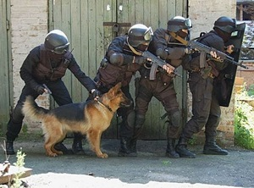
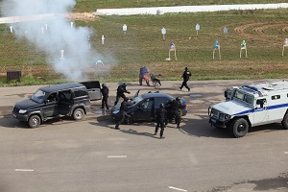
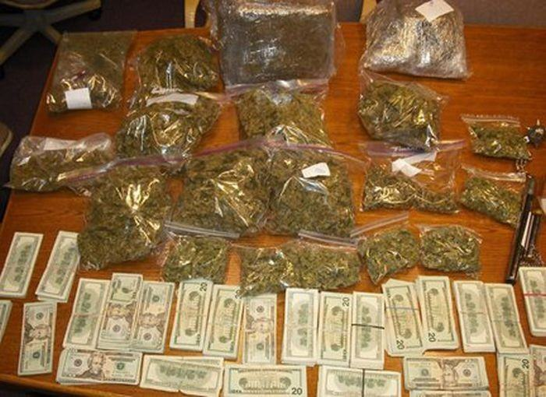
Collective Security Treaty Organization
The CSTO member states have gained considerable experience of interaction in the field of fighting against illicit drug trafficking, including:
the exchange of operational information during the joint operations;
training of interstate and interagency cooperation between different CSTO member states force authorities, including police, security services, customs and border bodies, financial intelligence units as well as armed forces.

Slide 9
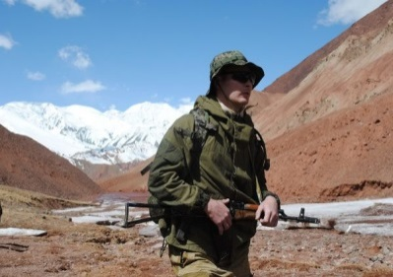
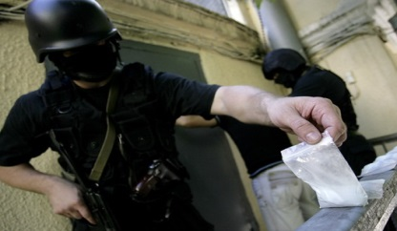
Collective Security Treaty Organization
Counter-drug operations «Channel»:
«Channel-Western barrier» international counter-drug operation (may-june 2017, Brest, Republic of Belarus);
«Channel-Volzskiy barrier» subregional international counter-drug operation (oktober 2017,Saratov, Russian Federation);
«Channel-Kordon 2018» international counter-drug operation (may-june 2018, Cholpon-Ata, Kyrgyz Republic);
«Channel -Red Barkhan » regional counter-drug operation (september 2018, Shymkent, Republic of Kazakhstan);
«Channel-Center» international counter-drug operation
(February-march 2019, Alma-Ata, Republic of Kazakhstan, CARICS);
«Channel-Kavkaz redut» subregional counter-drug operation (September 2019, Yerevan, Republic of Armenia).

Slide 10
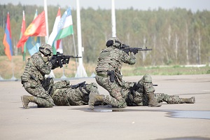
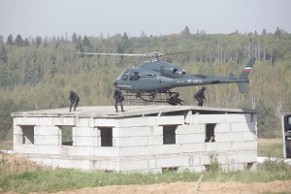
Collective Security Treaty Organization
«CHANNEL-WESTERN BARRIER»
International counter-drug operation
May-june - 2017, Brest, Republic of Belarus
OPERATION RESULTS:
Total drugs 16 796 kg
Heroin 41 kg
Opium 15 500 kg
Hashish 647 kg
Synthetic drugs 244 kg
and other drugs 364
Fire arms 270 pcs

Slide 11
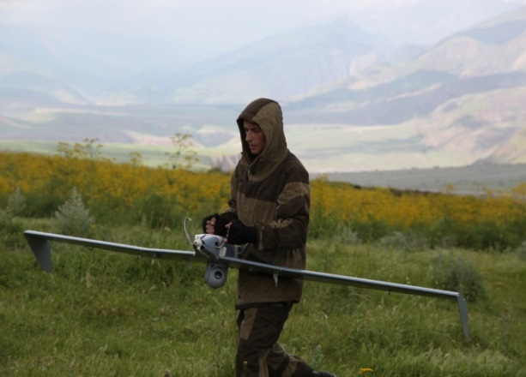
Collective Security Treaty Organization
«CHANNEL-VOLZSKIY BARRIER»
Subregional international counter-drug operation
Oktober - 2017, Saratov, Russian Federation
OPERATION RESULTS:
Total drugs seizures 5 092 kg
Heroin 219 kg
Opium 2 776 kg
Hashish 1365 kg
Synthetic drugs 59 kg
and other drugs 673 kg
Fire arms 114 pcs

Slide 12
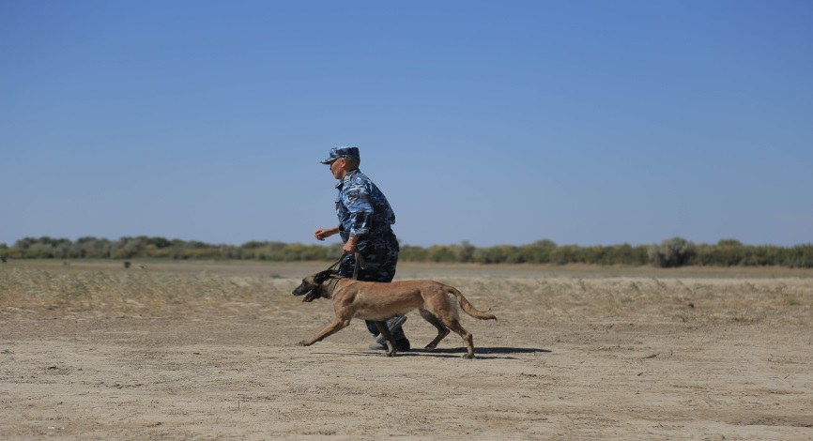
Collective Security Treaty Organization
«CHANNEL-KORDON 2018»
International counter-drug operation
May-june - 2018, Cholpon-Ata, Kyrgyz Republic
OPERATION RESULTS:
Total drugs seizures 5 515 kg
Heroin 85 kg
Opium 4 753 kg
Hashish 418 kg
Synthetic drugs 9,5 kg
and other drugs 249,5 kg
Fire arms 72 pcs

Slide 13
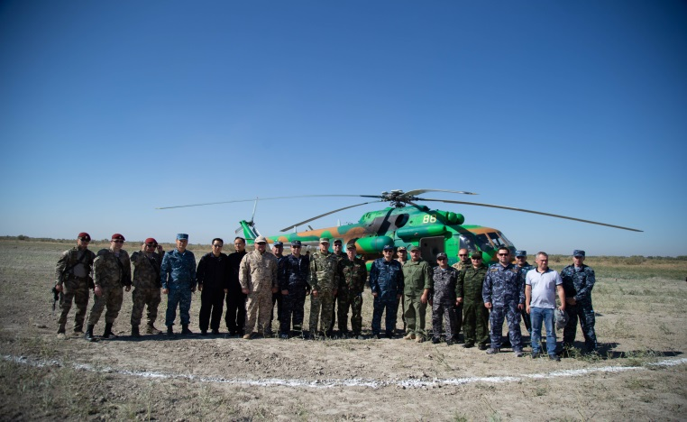
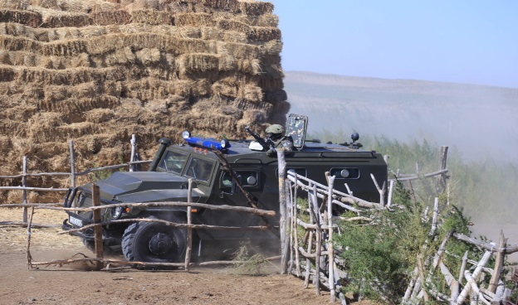
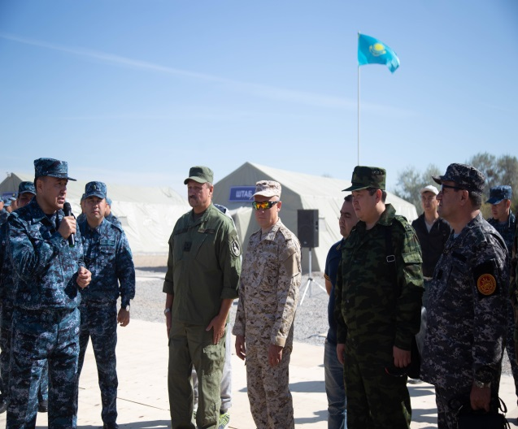
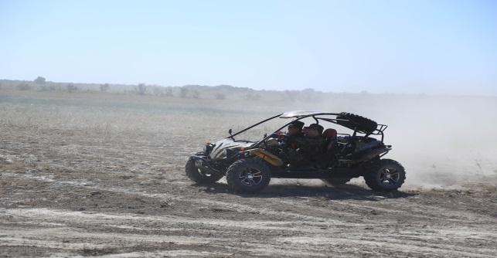
Collective Security Treaty Organization
«CHANNEL-RED BARKHAN»
Regional counter-drug operation
September - 2018, Shymkent, Republic of Kazakhstan
OPERATION RESULTS:
Total drugs seizures 11 132 kg
Opium 7 000 kg
Hashish 931 kg
Synthetic drugs 144 kg
and other drugs 3 057 kg
Fire arms 335 pcs

Slide 14
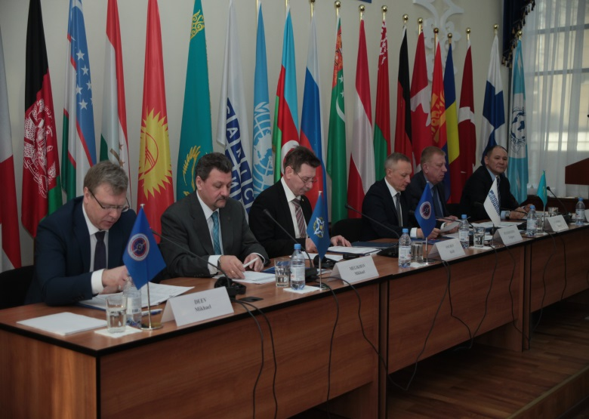
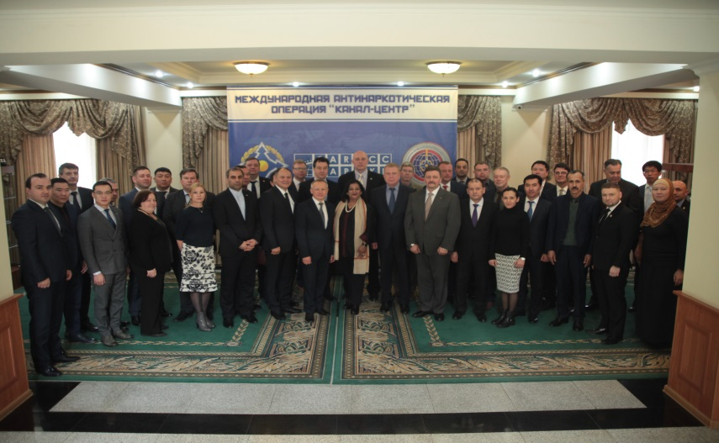
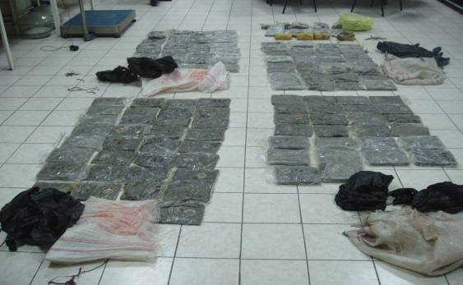
Collective Security Treaty Organization
«CHANNEL-CENTER»
International counter-drug operation
February-march - 2019, Alma-Ata, Republic of Kazakhstan, CARICS
OPERATION RESULTS:
Total drugs seizures 11 414 kg
Heroin 221 kg
Opium 6 533 kg
Hashish 1 817 kg
Synthetic drugs 205 kg
and other drugs 109 kg
Fire arms 307 pcs

Slide 15
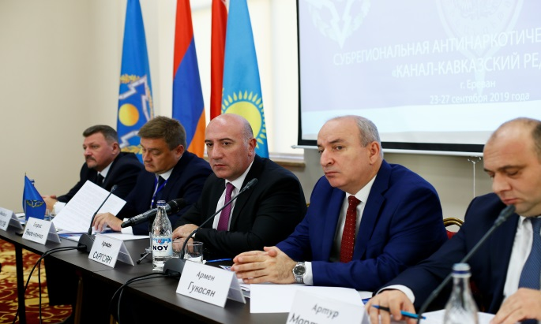
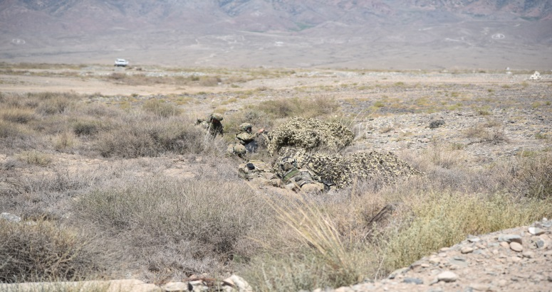
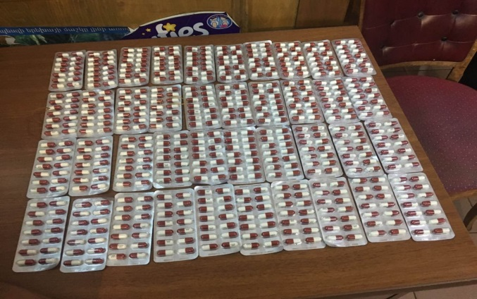
Collective Security Treaty Organization
«CHANNEL-KAVKAZ REDUT»
Subregional counter-drug operation
September - 2019, Yerevan, Republic of Armenia
OPERATION RESULTS
Total drugs seizures 17 400 kg
Heroin 137 kg
Opium 10 541 kg
Hashish 472 kg
Synthetic drugs 49 kg
and other drugs 6201 kg
Fire arms 239 pcs

Slide 16
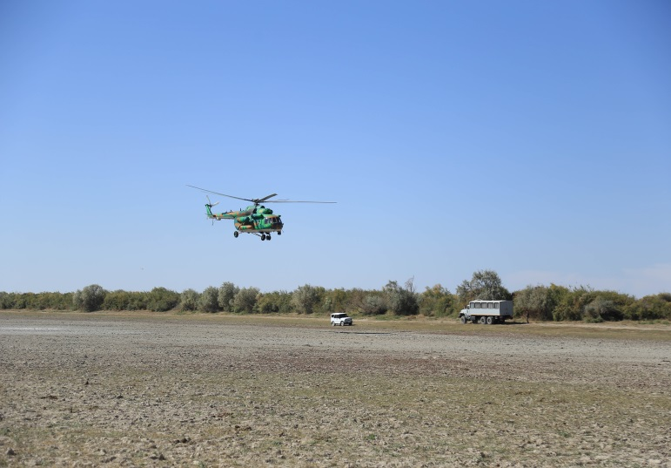
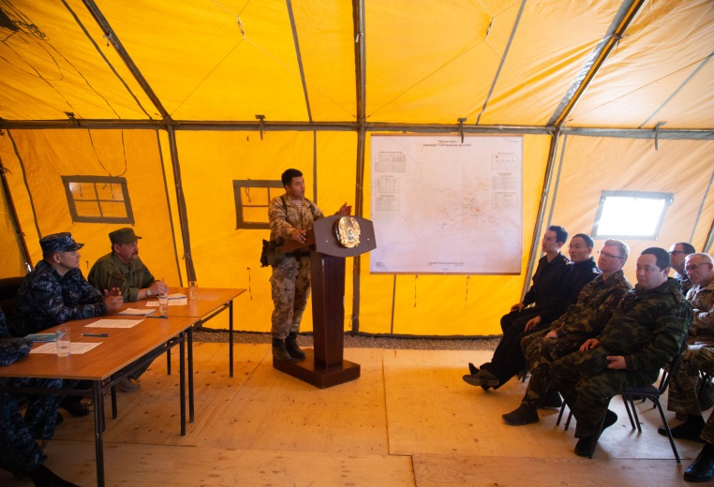
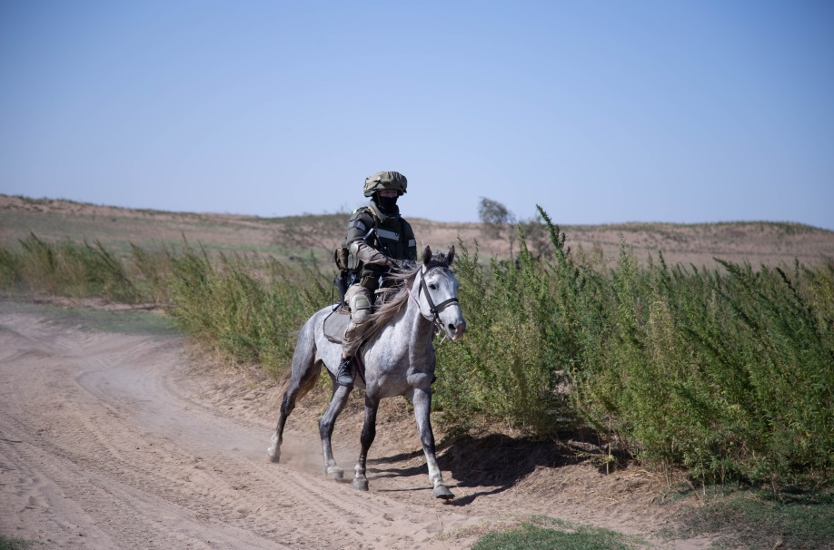
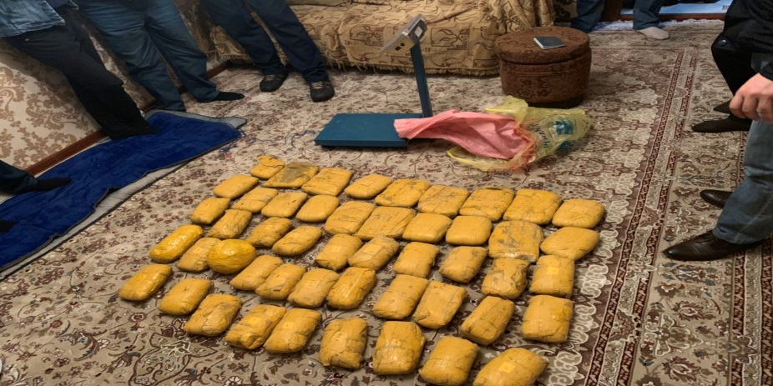
Collective Security Treaty Organization

Slide 17
The Siberian Law Institute of The Ministry of Internal Affairs of The Russian Federation Federal State Institution of Additional Professional Education «All-Russian Advanced Training Institute of The Ministry of Internal Affairs of The Russian Federation»
According to the CSTO Collective Security Council resolution, was given the status of the basic educational institutions of higher and additional professional education in preparing specialists in the field of drugs control for the Collective Security Treaty Organization member states.

Slide 18
